Slide 1
Summary of NGSS Statistical Results
Bruce Schaalje, Nov. 2, 2022

Slide 2
Bucket Elevator
To Bulk Bins
Grinnell EFD
DOC70 Current
Process
Sheller
Bulk Batch example is ~24,000 bu
Existing Sampler grabs <1 lb samples on a fixed duration and frequency timer during entire run
Goal is to collect 200lbs of seed by the end of the run
Sampler frequency timing is set before run based on an estimate of the total run time of the batch
Sheller Bin
500 bu
Existing Gamet Sampler
<1 lbs/sample
Sample Bin
200lb capacity
500lb Batch Scale
20 lbs of seed (0.002%) are examined for a batch run
+/- 10% Error
10:1 Splitter
50:50 Splitter
~180lbs waste seed
Two 10lb Samples for DOC70

Slide 3
DOC-70: Single Composite Sampling
batch processing time
•
•
•
200 1-lb samples combined as 1 large composite sample
1 20-lb sample split into 2 10-lb subsamples
1 measurement for each 10-lb subsample
sample
sample
measurement
measurement

Slide 4
Bucket Elevator
To Bulk Bins
Grinnell EFD
NGSS Current
Process
Sheller
Bulk Batch is ~24,000 bu
Sampler grabs <1 lb samples on a fixed duration and frequency timer during entire run
Goal is to collect samples as fast as NGSS and the 5lb Batch Scale can process them, currently 200 seeds/second
Each 5lb weighment is processed individually by NGSS, giving a measurement of the number of seeds of each size per pound of mixed material in the bulk bin
Sheller Bin
500 bu
Existing Gamet sampler
<1lb/sample
5 lb Batch Scale
500lb Batch Scale
NGSS Hopper
NGSS
NGSS can ideally examine 4800 lbs of seed (0.4%) during a batch run
Seed is returned to bulk bin after analysis

Slide 5
NGSS Multiple Composite Sampling
batch processing time
200 1-lb samples
combined as 40 sequential 5-lb composites
1 measurement for each 5-lb composite
•
•
•
meas.
meas.
meas.
meas.

Slide 6
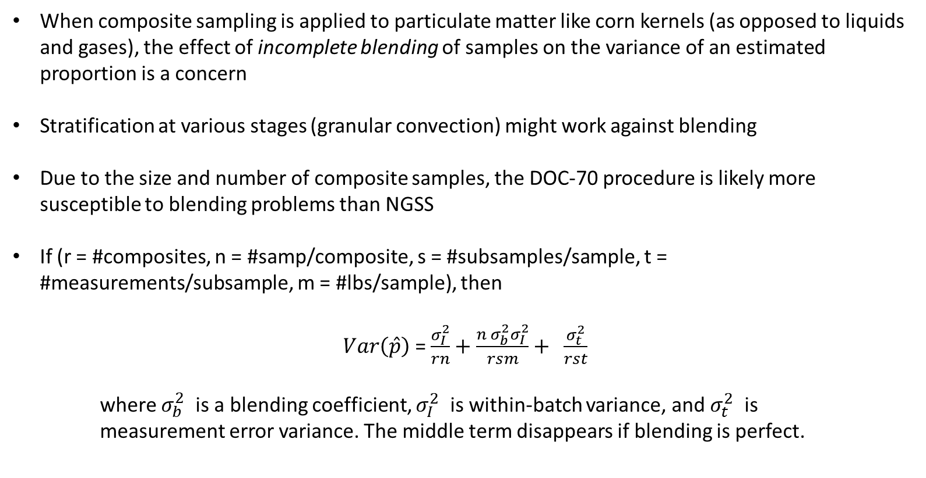
Variability of Composite Sampling Results
When composite sampling is applied to particulate matter like corn kernels (as opposed to liquids and gases), the effect of incomplete blending of samples on the variance of an estimated proportion is a concern
Stratification at various stages (granular convection) might work against blending
Due to the size and number of composite samples, the DOC-70 procedure is likely more susceptible to blending problems than NGSS
If (r = #composites, n = #samp/composite, s = #subsamples/sample, t = #measurements/subsample, m = #lbs/sample), then
$Var\left(\hat{p}\right)$ = $\frac{σ_{I}^{2}}{rn}+\frac{n σ_{b}^{2}σ_{I}^{2}}{rsm}+ \frac{σ_{t}^{2}}{rst}$
where $σ_{b}^{2}$ is a blending coefficient, $σ_{I}^{2}$ is within-batch variance, and $σ_{t}^{2}$ is measurement error variance. The middle term disappears if blending is perfect.

Slide 7
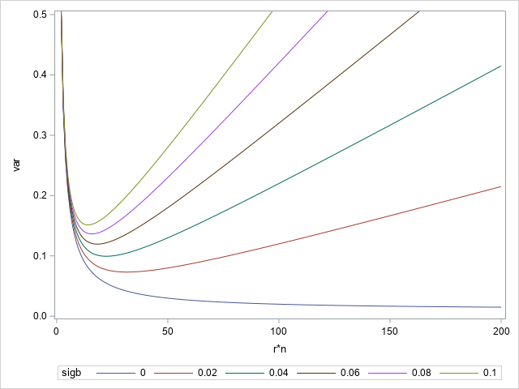
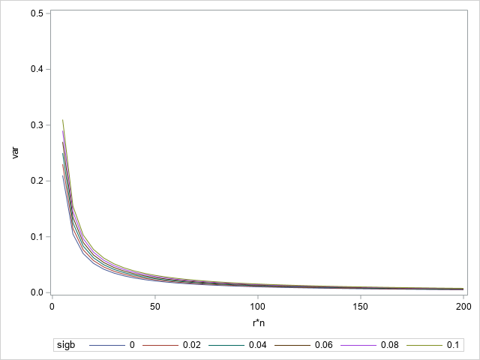

Variance Comparison
$Var\left(\overline{x}\right)$ = ${\left(.005 +10{ σ}_{b}^{2}\right)σ}_{I}^{2}{+\left(.5\right)σ}_{t}^{2}$
$Var\left(\overline{x}\right)$ =${ \left(.005 +.025{ σ}_{b∗}^{2}\right)σ}_{I}^{2}{+\left(.025\right)σ}_{t∗}^{2}$
DOC-70
NGSS
(assume $σ_{I}^{2}=1,σ_{t}^{2}=.01$)
With equal numbers (200) of basic 1-lb samples, variances are likely to be much smaller with NGSS than DOC-70
NGSS sample numbers and sample sizes can be increased with relatively little increase in cost

Slide 8
2019 Data
* In some slides, proportions (p) are transformed by the logistic or log_odds transformation [logit_p = log(p/(1-p)]. This transformation retains order, but it spreads out values near 0 or 1.

Slide 9
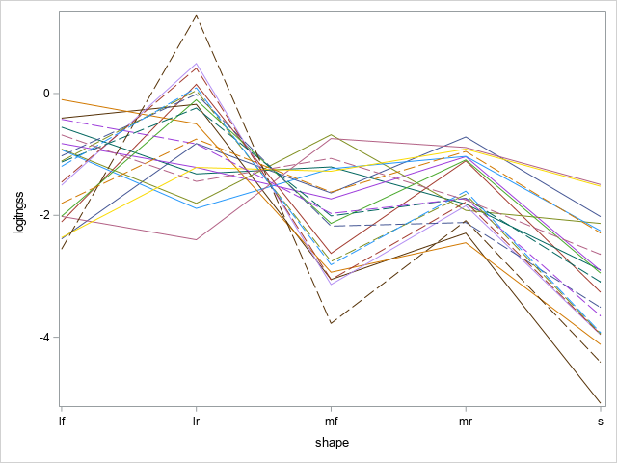
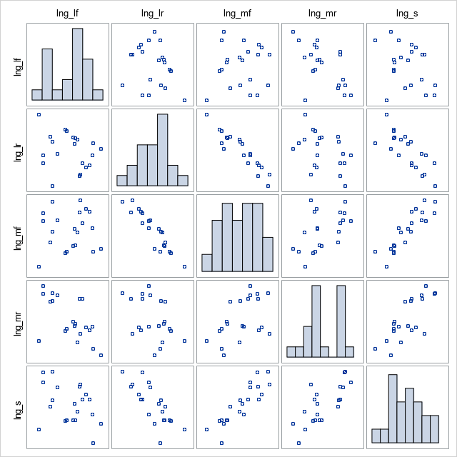
Distribution and Correlation Structure for NGSS Proportions Across 22 Batches

Slide 10
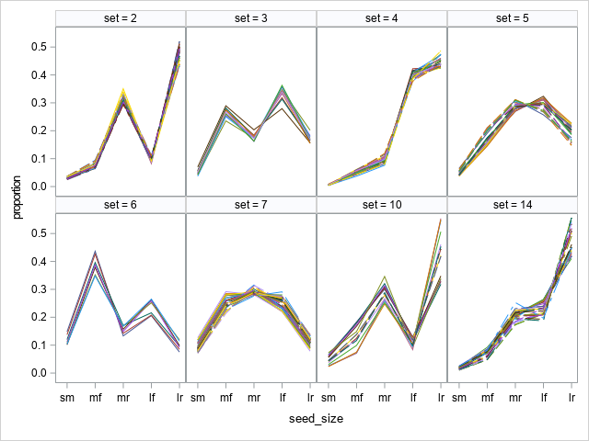
NGSS data for repeated 5-lb weighments from several bins
3 sources of variation
between-batch heterogeneity (among-panels)
within-batch heterogeneity (among-colored lines) composed of
between-weighment variation (very little here)
process, sampling, and measurement variation

Slide 11
Joint Statistical Model for Composite Sampling Results

Slide 12
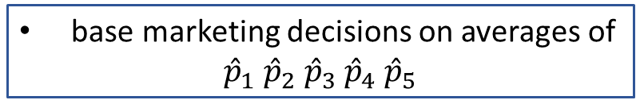
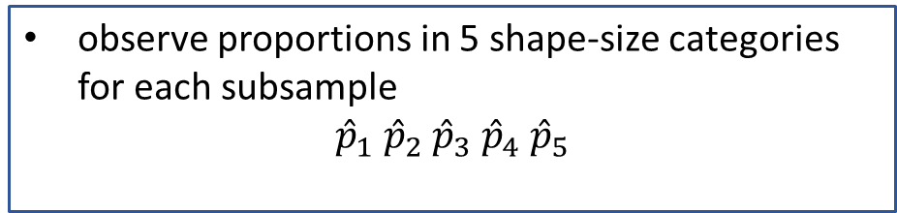
take n x-lb samples at various time-points in filling process
Basic Model
1
2
3
n
. . .
mix n samples into 1 composite sample
take m y-lb subsamples
. . .
1
m
model using Dirichlet distribution with shape parameters for population heterogeneity and measurement heterogeneity
observe proportions in 5 shape-size categories for each subsample
$${\hat{p}}_{1} {\hat{p}}_{2} {\hat{p}}_{3} {\hat{p}}_{4} {\hat{p}}_{5}$$
base marketing decisions on averages of
$${\hat{p}}_{1} {\hat{p}}_{2} {\hat{p}}_{3} {\hat{p}}_{4} {\hat{p}}_{5}$$

Slide 13
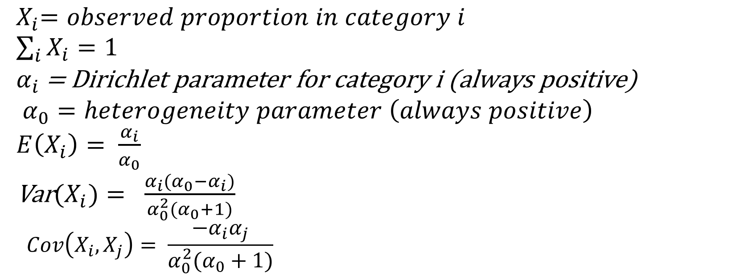
Dirichlet model facts
${ X}_{i}=observed proportion in category i$
$\sum_{i}{X_{i}}=1$
${ α}_{i}$ = Dirichlet parameter for category i (always positive)
$$α_{0}=heterogeneity parameter \left(always positive\right)$$
$E\left(X_{i}\right)= \frac{α_{i}}{α_{0}}$
Var($X_{i})= \frac{α_{i}(α_{0}−α_{i})}{α_{0}^{2}(α_{0}+1)}$
$$Cov\left(X_{i},X_{j}\right)= \frac{−α_{i}α_{j}}{α_{0}^{2}(α_{0}+1)}$$
Note that all correlations are negative

Slide 14
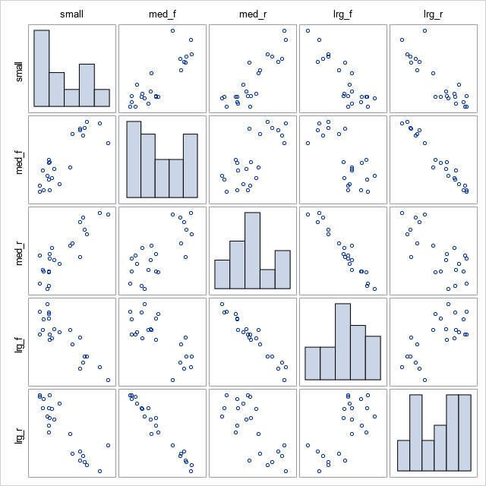
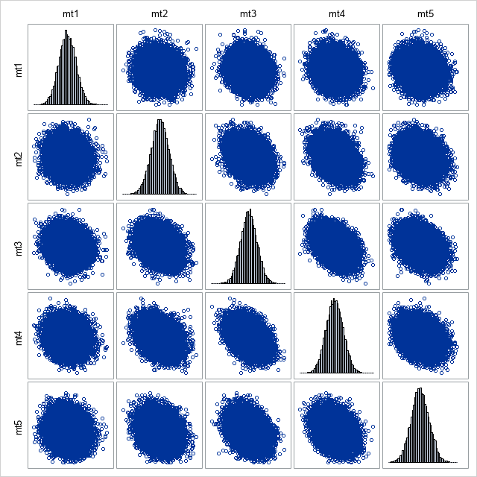
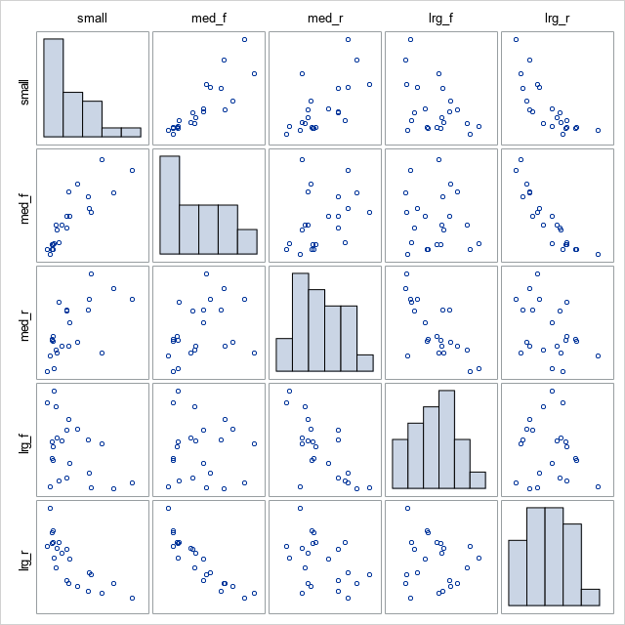
Data
Basic Model Fit
Simulated Data for Fitted Dirichlet Model

Slide 15
take n x-lb samples at various time-points in filling process
Generalized Model
1
2
3
n
. . .
mix n samples into 1 composite sample
take m y-lb subsamples
. . .
1
m
Dirichlet models
etc.
s
mf, mr
lf, lr
Dirichlet models
mf
mr
lf
lr

Slide 16
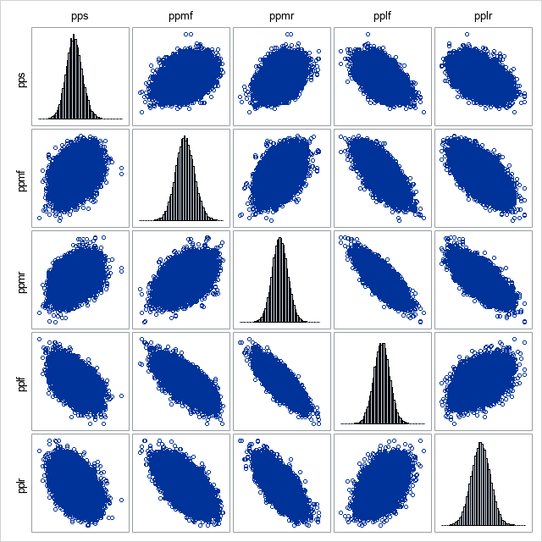
Data
Generalized Model Fit
Simulated Data for Fitted Generalized Dirichlet Model

Slide 17
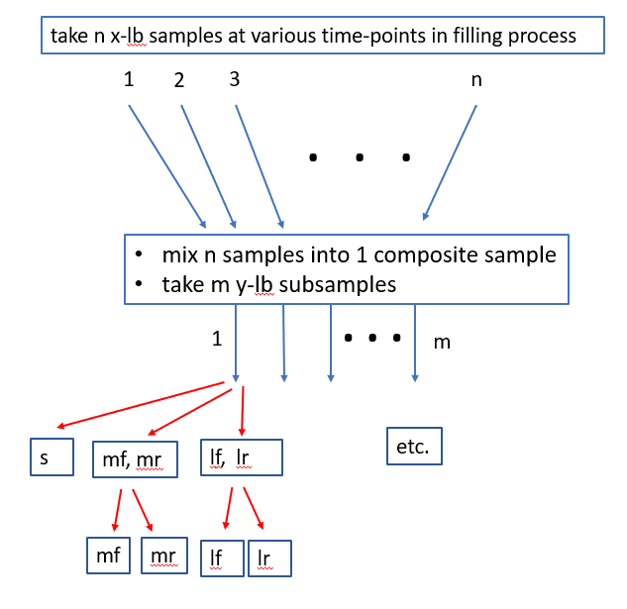
Include Within-Batch Heterogeneity of Proportion Profiles
select proportion profile at random (Dirichlet model)

Slide 18
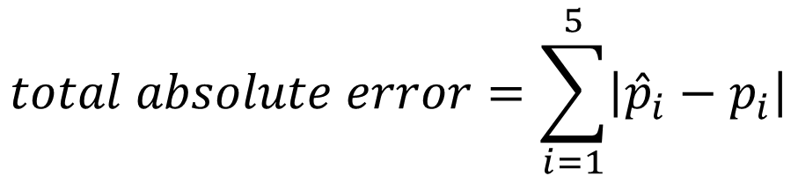
Measure of Discrepancy
$$total absolute error=\sum_{i=1}^{5}{\left|{\hat{p}}_{i}−p_{i}\right|}$$

Slide 19
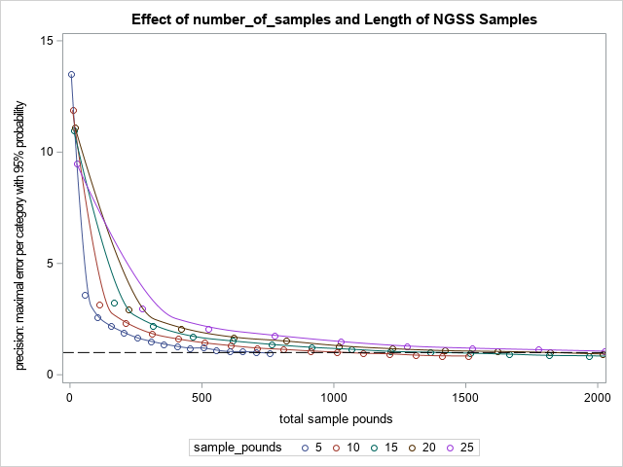
600 total lbs achievable by current NGSS at 25 seeds/sec
NGSS rate is 200 seeds/sec
100% uptime: 4800lbs
80% uptime: 3840lbs
50% uptime: 2400lbs
Seeds/lb ~1800
~24,000 bu bulk batch
eg. sample 600 total lbs (120 5-lb samples) to achieve precision of 1 percentage point per category with 95% power

Slide 20
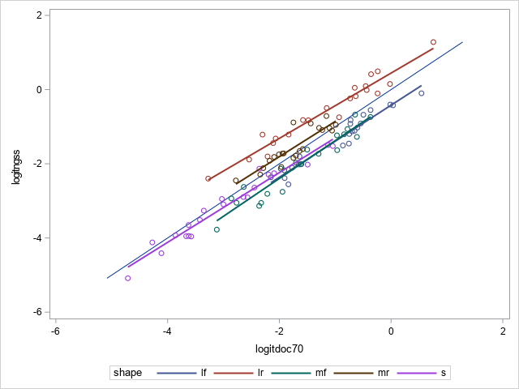
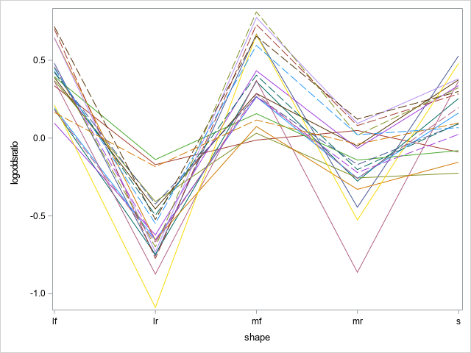
Relationship Between NGSS and Handshake* for 22 Batches
* the full DOC-70 composite sampling process was not used

Slide 21
Talking Points
assumptions:
nested Dirichlet model
no bias
current NGSS machine
1800 seeds/lb
200 seeds/sec
24,000 bu/bulk batch
equally spaced samples
ignores post-storage discards, etc. (doesn’t predict proportions of final product)
number of samples = total sample pounds/ sample_pounds
"precision" for doc70 based on 100%, 75% and 50% error assumptions
1
200

Slide 22
Issues
unacceptable fit of model to data
more to this sampling process than randomness and heterogeneity of Dirichlet model
layering and mixing can be a problem with composite sampling of granular material
Plan
Develop generalized statistical sampling model.
Make results applicable to broad range of seed size proportion profiles.
Propose useful measure of discrepancy between estimates and actual proportion profiles.
Investigate optimal values of n, x, m, and y for sampling with θ % power and margin of error δ .

Slide 23
2. Variety of Proportion Profiles

Slide 24
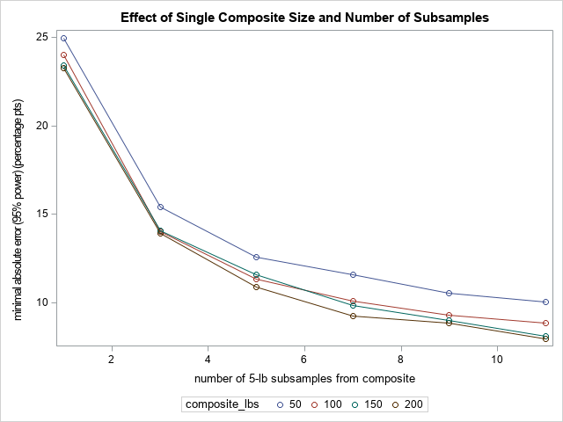

Slide 29
Agreement Analysis
2022 data
Not possible for 2019 data

Slide 30
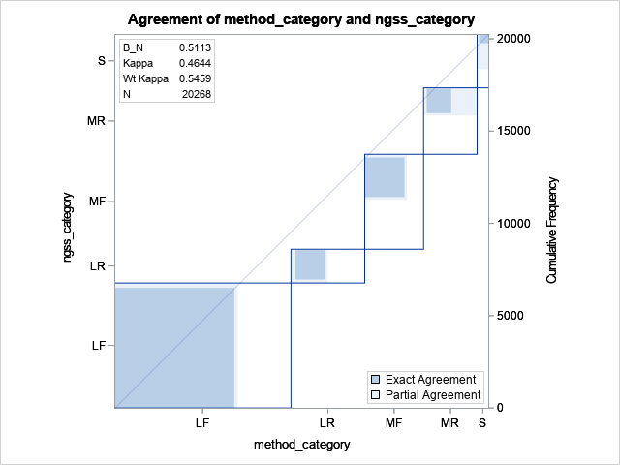
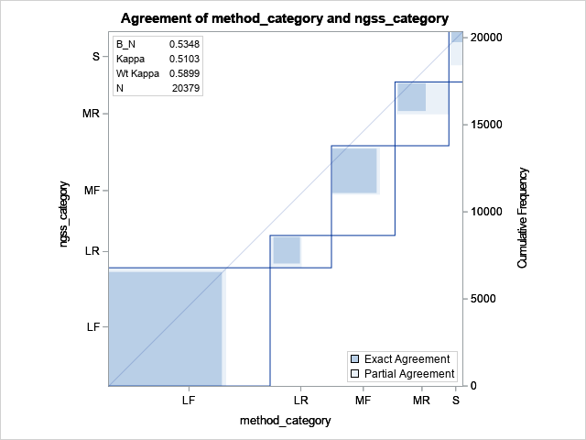
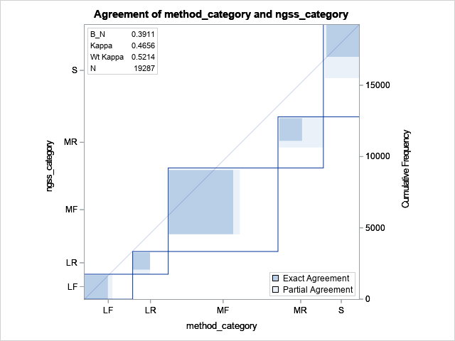
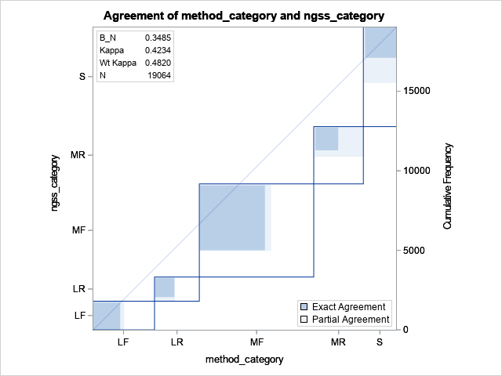
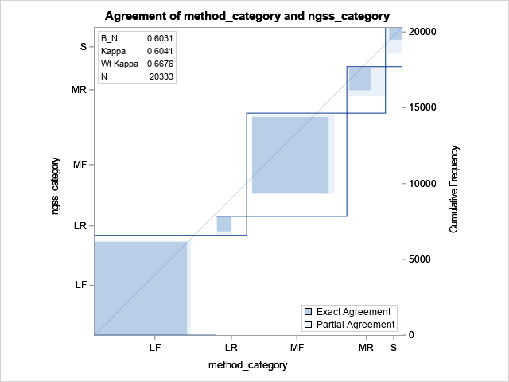
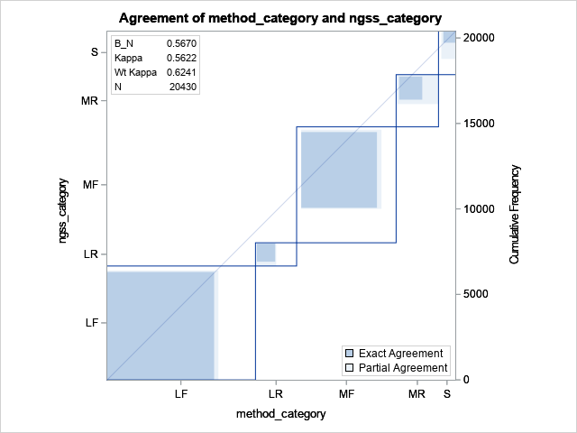
Shakeout Handscreen
Set 2022-0228
XY42B
batch | method | agreement | kappa
9P92B | Handscre | 0.59587 | 0.46441
9P92B | Shakeout | 0.63089 | 0.51027
PP32B | Handscre | 0.54632 | 0.42336
PP32B | Shakeout | 0.58438 | 0.46560
XY42B | Handscre | 0.67876 | 0.56221
XY42B | Shakeout | 0.71077 | 0.60412
PP32B
9P92B

Slide 31
Observations
Uncorrected agreement between ngss and screening methods is around 75% (lower than hoped)
Shakeout agreement is usually 2-3% higher than handscreen agreement with ngss
Wide variety of relative proportions in shape-size classes among batches
Usually either LF or MF is dominant category
Common disagreement patterns
Shakeout methods usually categorize more kernels as LF than ngss, with excess kernels coming mainly from MF
Shakeout methods usually categorize more kernels as LR than ngss, with excess kernels coming mainly from MR

Slide 32
Comparison of 2019 Data to 2022 Data

Slide 33
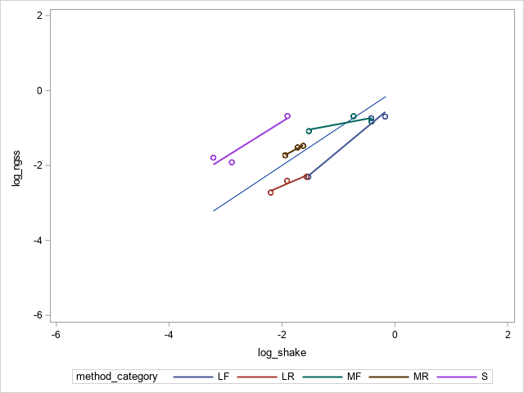
2019 data
2022 data
patterns are very different between 2019 and 2022 data:
small proportions are consistently smaller in ngss than shakeout for 2019, but consistently larger in ngss than shakeout for 2022
large round proportions are consistently larger in ngss than shakeout for 2019, but consistently smaller in ngss than shakeout for 2022

Slide 34
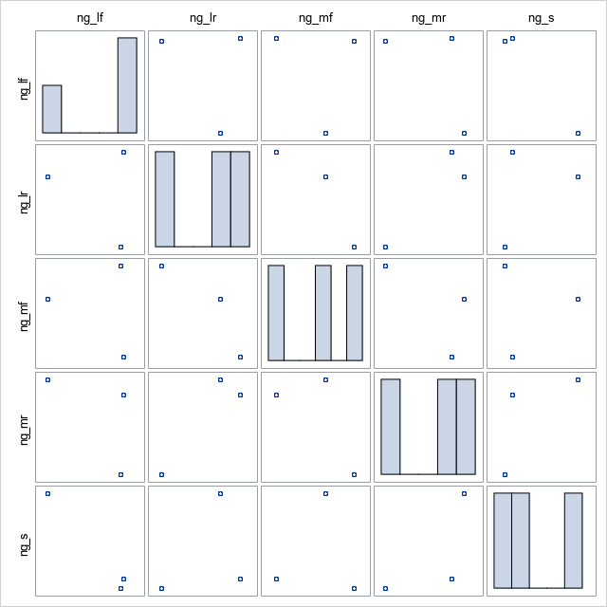
2019 data
2022 data
apparent good agreement between years

Slide 35
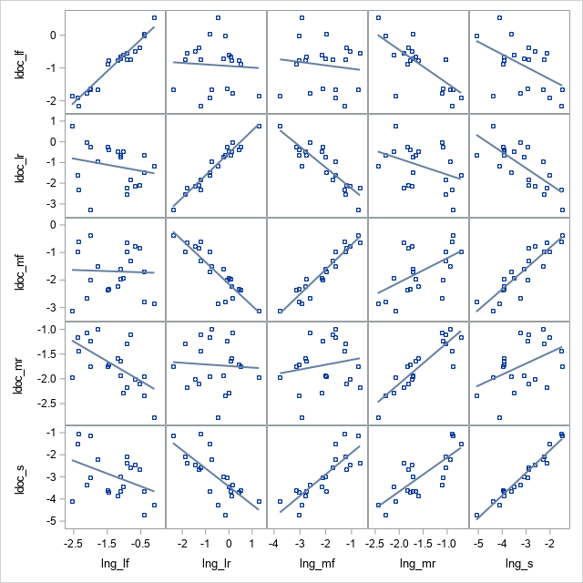
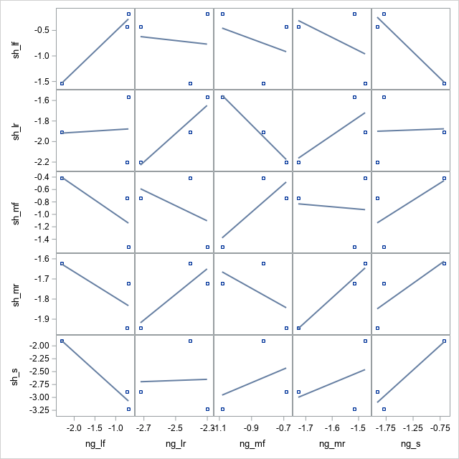
2019 data
2022 data
good agreement between years
relationship is reversed for lng_lr vs ldoc_mr, lng_lr vs ldoc_s, and lng_mf vs ldoc_mf

Slide 36
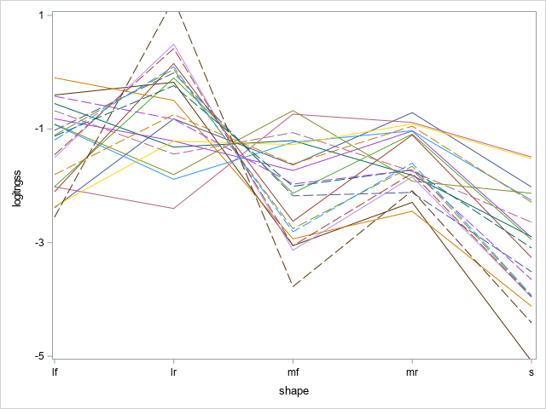
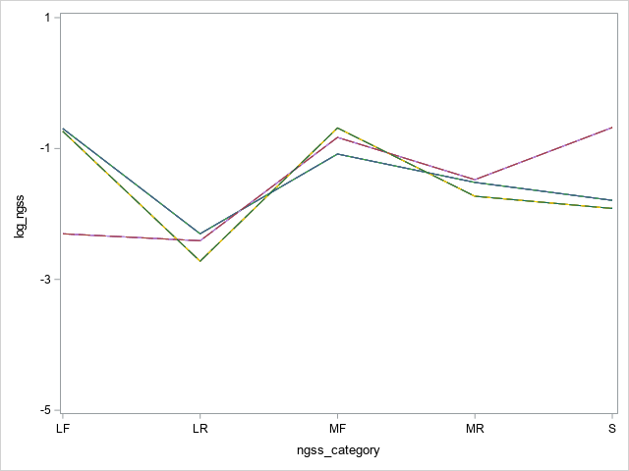
2019 data
2022 data
patterns very different between years

Slide 37
